Slide 1
Integração de Sistemas de Informação
Engenharia de Sistemas Informáticos
Ano letivo de 2022/23

Slide 2
Utilização de XML em C#

Slide 3
Transformar um documento XML
O documento XML é transformado num outro formato antes que este seja colocado no cliente. Esta transformação é da responsabilidade de um programa auxiliar (serializador).

Slide 4
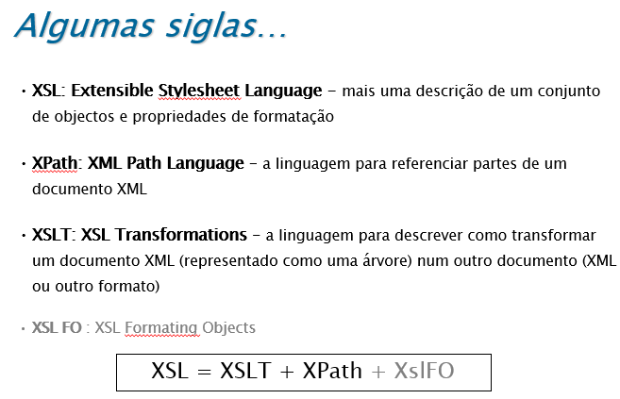
Transformar documentos XML
XSL = XSLT + XPath + XslFO

Slide 5
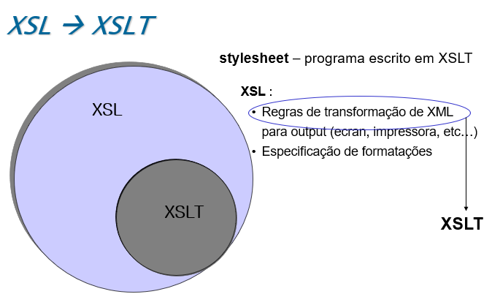
Transformar documentos XML

Slide 6
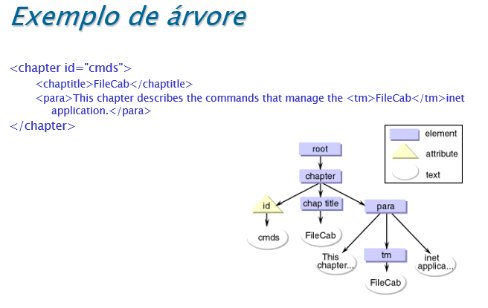
Processo de transformação

Slide 7
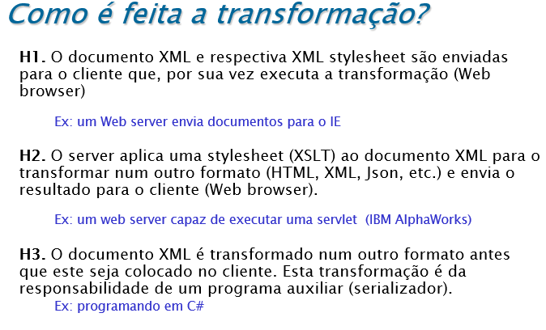

Slide 8
Transformação de XML
No contexto desta UC vamos abordar a hipótese H3
Desenvolvimento de um programa auxiliar (serializador) para transformar documentos XML
Utilização da linguagem XPath para auxiliar no desenvolvimento
A questão relacionadas com as XSL e XLST não serão abordadas nas aulas
  Nos diapositivos de introdução ao XML tem um conjunto de informação acerca deste tema...
Notes:
Luís Ferreira (2016), Integração de Sistemas de Informação, Parte I - versão 5.0 - Janeiro 2016
, Parte II - versão 1.0 - Janeiro 2017
Bibliografia complementar:
Urls
http://www.tutorialspoint.com/webservices/
http://www.linkeddatatools.com/
http://eai.ittoolbox.com/

Slide 9
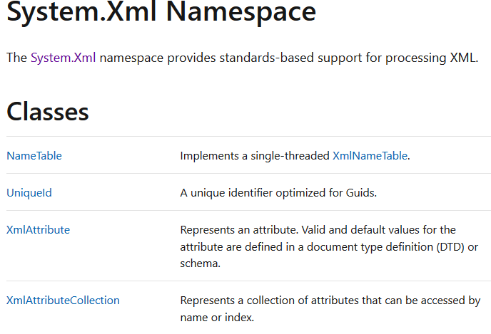
Namespace System.Xml
.NET System.Xml Namespace
https://docs.microsoft.com/en-us/dotnet/api/system.xml
Notes:
https://docs.microsoft.com/en-us/dotnet/api/system.xml
https://docs.microsoft.com/en-us/dotnet/api/system.xml?view=netframework-4.8

Slide 10
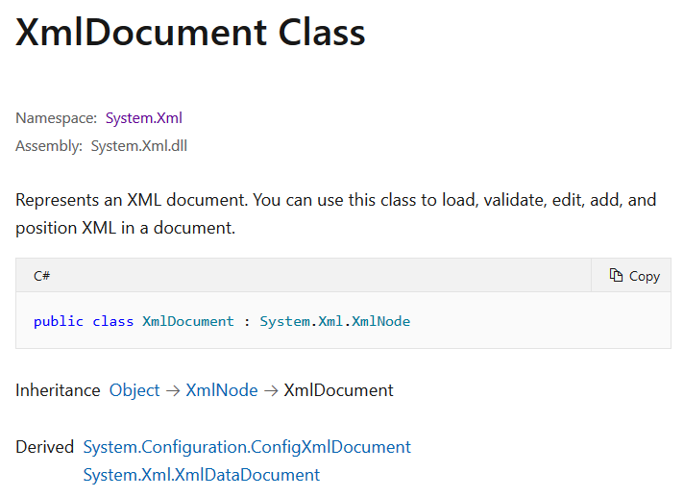
Namespace System.Xml
System.XmlDocument Class
https://docs.microsoft.com/en-us/dotnet/api/system.xml.xmldocument
Notes:
https://docs.microsoft.com/en-us/dotnet/api/system.xml
https://docs.microsoft.com/en-us/dotnet/api/system.xml?view=netframework-4.8

Slide 11
Namespace System.Xml
System.XmlDocument Class
Permite obter uma representação em memória de um documento XML
Segue a representação sugerida pelo standard document object model (DOM), em particular as seguintes especificações:
  Document Object Model (DOM) Level 1 Core
  Document Object Model (DOM) Level 2 Core
No contexto do XmlDocument é permitida a leitura (XMLReader) e navegação na árvore correspondente ao documento XML e também algumas alterações
https://docs.microsoft.com/en-us/dotnet/standard/data/xml/xml-document-object-model-dom
Notes:
https://docs.microsoft.com/en-us/dotnet/api/system.xml.xmldocument?view=netframework-4.8#remarques
The XmlDocument class is an in-memory representation of an XML document. It implements the W3C XML Document Object Model (DOM) Level 1 Core and the Core DOM Level 2.
DOM stands for document object model. To read more about it, see XML Document Object Model (DOM).
You can load XML into the DOM by using the XmlDocument class, and then programmatically read, modify, and remove XML in the document.
If you want to pry open the XmlDocument class and see how it's implemented, see the Reference Source.

Slide 12
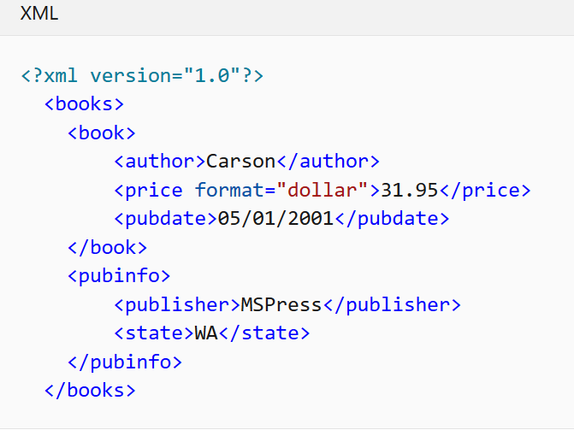
XML Document Object Model (DOM)
XmlDocument doc = new XmlDocument();
doc.Load(@"d:\temp\Data\books.xml");
Notes:
XML Document Object Model (DOM)
https://docs.microsoft.com/en-us/dotnet/standard/data/xml/xml-document-object-model-dom
The XML Document Object Model (DOM) class is an in-memory representation of an XML document. The DOM allows you to programmatically read, manipulate, and modify an XML document. The XmlReader class also reads XML; however, it provides non-cached, forward-only, read-only access. This means that there are no capabilities to edit the values of an attribute or content of an element, or the ability to insert and remove nodes with the XmlReader. Editing is the primary function of the DOM. It is the common and structured way that XML data is represented in memory, although the actual XML data is stored in a linear fashion when in a file or coming in from another object. The following is XML data.

Slide 13
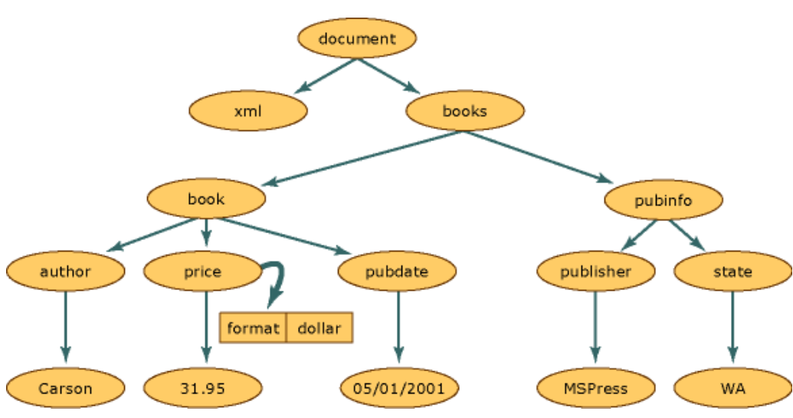
XML Document Object Model (DOM)
representação do documento XML seguindo a estrutura DOM
Notes:
The following illustration shows how memory is structured when this XML data is read into the DOM structure.

Slide 14
XML Document Object Model (DOM)
representação do documento XML seguindo a estrutura DOM
  XmlNode é o objeto base na árvore DOM
  A classe XmlDocument, estende XmlNode, e disponibiliza um conjunto de operações sobre o documento como um todo (exemplo: ler, ou escrever, para um ficheiro )
XmlNode object
Notes:
The following illustration shows how memory is structured when this XML data is read into the DOM structure.
he XmlNode object is the basic object in the DOM tree. The XmlDocument class, which extends XmlNode, supports methods for performing operations on the document as a whole (for example, loading it into memory or saving the XML to a file.

Slide 15
Namespace System.Xml
Ver Exemplos XML_C#
System.XmlDocument Class
Carregar XML para uma estrutura DOM em memória
booksData.xml
<?xml version="1.0" encoding="utf-8"?>
<books xmlns="http://www.contoso.com/books">
<book genre="novel" ISBN="1-861001-57-8">
<title>Pride And Prejudice</title>
<price>24.95</price>
</book>
<book genre="novel" ISBN="1-861002-30-1">
<title>The Handmaid's Tale</title>
<price>29.95</price>
</book>
<book genre="novel" ISBN="1-861001-45-3">
<title>Sense and Sensibility</title>
<price>19.95</price>
</book>
</books>
example01.cs
XmlDocument doc = new XmlDocument();
doc.PreserveWhitespace = true;
try { doc.Load("booksData.xml"); }
catch (System.IO.FileNotFoundException)
{
doc.LoadXml(
"<?xml version=\"1.0\"?> \n" +
"<books"> \n" +
"</books>");
}
Notes:
TASKS
Load XML into the document object mode

Slide 16
Namespace System.Xml
System.XmlDocument Class
Apresentar o elemento raiz
XmlDocument doc = new XmlDocument();
doc.LoadXml("<?xml version='1.0' ?>" +
"<book genre='novel' ISBN='1-861001-57-5'>" +
"<title>Pride And Prejudice</title>" +
"</book>");
//mostrar o valor do elemento raiz na consola
Console.WriteLine(doc.DocumentElement.OuterXml);
Notes:
TASKS
Load XML into the document object mode
doc.DocumentElement.OuterXml
Conteúdo de doc sem <?xml

Slide 17
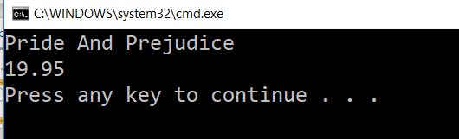
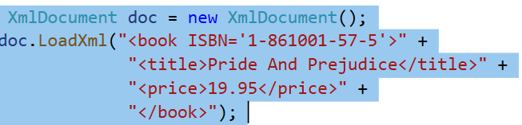
Namespace System.Xml
System.XmlDocument Class
Percorrer a subárvore do primeiro nodo filho
...
XmlNode root = doc.FirstChild;
if (root.HasChildNodes)
{
for (int i=0; i<root.ChildNodes.Count; i++)
{
Console.WriteLine(root.ChildNodes[i].InnerText);
}
}
Notes:
TASKS
Load XML into the document object mode

Slide 18
Namespace System.Xml
System.XmlDocument Class
Encontrar um conjunto de nodos (pesquisa por nome da etiqueta):
...
XmlNodeList elemList = doc.GetElementsByTagName("title");
for (int i=0; i < elemList.Count; i++)
{
Console.WriteLine(elemList[i].InnerXml);
}
Notes:
modified XML document...."); doc.Save(Console.Out); } }

Slide 19
Namespace System.Xml
System.XmlDocument Class
Encontrar um nodo em particular (pesquisa por atributo do tipo id):
...
XmlNode elem = doc.GetElementsById(“a1");
Console.WriteLine(elem.InnerXml);
Notes:
modified XML document...."); doc.Save(Console.Out); } }

Slide 20
Namespace System.Xml
System.XmlDocument Class
Como procurar um ou vários nodos na estrutura DOM?
Uma das soluções mais utilizada é recorrer a uma string Xpath Query…
Notes:
Find nodes
The most popular way to find one or more nodes of data is to use an XPath query string, but there are also methods that don't require one.

Slide 21
XPath
XML Path Language (XPath) é utilizada para fazer interrogações acerca da informação num objeto DOM
Notes:
https://docs.microsoft.com/en-us/dotnet/standard/data/xml/select-nodes-using-xpath-navigation
Select Nodes Using XPath Navigation
03/30/2017
4 minutes to read
+5
The XML Document Object Model (DOM) contains methods that allow you to use XML Path Language (XPath) navigation to query information in the DOM. You can use XPath to find a single, specific node or to find all nodes that match some criteria.

Slide 22
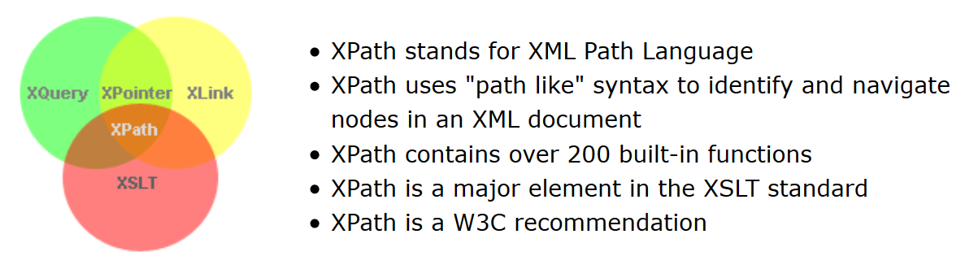
XPath
XML Path Language (XPath) é utilizada para fazer interrogações acerca da informação num objeto DOM
https://www.w3schools.com/xml/xpath_intro.asp
Notes:
What is XPath?
XPath is a major element in the XSLT standard.
XPath can be used to navigate through elements and attributes in an XML document.

Slide 23
Namespace System.Xml
Ver Exemplo Parsing em XML_C#
System.XmlDocument Class
Encontrar um nodo específico:
public XmlNode GetBook(string uniqueAttribute, XmlDocument doc)
{
string xPathString =
"//books/book[@ISBN='" + uniqueAttribute + "']";
XmlNode xmlNode =
doc.DocumentElement.SelectSingleNode(xPathString, nsmgr);
return xmlNode;
}
Notes:
Find nodes
The most popular way to find one or more nodes of data is to use an XPath query string, but there are also methods that don't require one.
Original inclui a parte do namespace
https://docs.microsoft.com/en-us/dotnet/standard/data/xml/select-nodes-using-xpath-navigation#xpath-select-methods
// Load the document and set the root element.
XmlDocument doc = new XmlDocument();
doc.Load("bookstore.xml");
XmlNode root = doc.DocumentElement;
// Add the namespace.
XmlNamespaceManager nsmgr = new XmlNamespaceManager(doc.NameTable);
nsmgr.AddNamespace("bk", "urn:newbooks-schema");
// Select and display the first node in which the author's
// last name is Kingsolver.
XmlNode node = root.SelectSingleNode(
"descendant::bk:book[bk:author/bk:last-name='Kingsolver']", nsmgr);
Console.WriteLine(node.InnerXml);

Slide 24
Namespace System.Xml
System.XmlDocument Class
Encontrar um nodo específico:
public XmlNode GetBook(string uniqueAttribute, XmlDocument doc)
{
string xPathString =
"//books/book[@ISBN='" + uniqueAttribute + "']";
XmlNode xmlNode =
doc.DocumentElement.SelectSingleNode(xPathString);
return xmlNode;
}
Notes:
Find nodes
The most popular way to find one or more nodes of data is to use an XPath query string, but there are also methods that don't require one.
Original inclui a parte do namespace
https://docs.microsoft.com/en-us/dotnet/standard/data/xml/select-nodes-using-xpath-navigation#xpath-select-methods
// Load the document and set the root element.
XmlDocument doc = new XmlDocument();
doc.Load("bookstore.xml");
XmlNode root = doc.DocumentElement;
// Add the namespace.
XmlNamespaceManager nsmgr = new XmlNamespaceManager(doc.NameTable);
nsmgr.AddNamespace("bk", "urn:newbooks-schema");
// Select and display the first node in which the author's
// last name is Kingsolver.
XmlNode node = root.SelectSingleNode(
"descendant::bk:book[bk:author/bk:last-name='Kingsolver']", nsmgr);
Console.WriteLine(node.InnerXml);

Slide 25
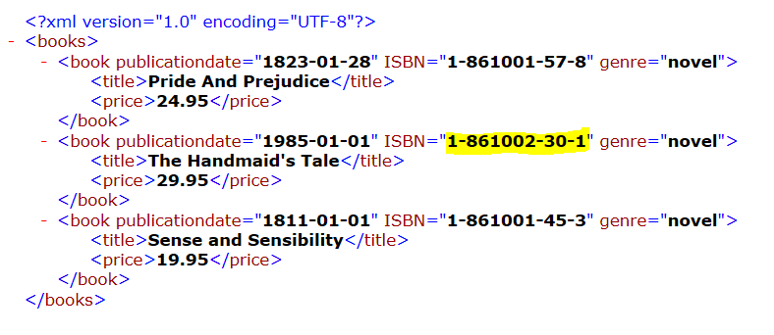

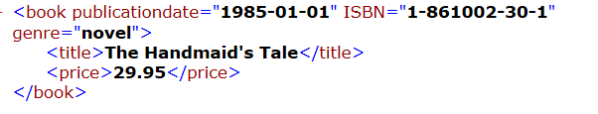
Namespace System.Xml
System.XmlDocument Class
Encontrar um nodo específico:
public XmlNode GetBook(string uniqueAttribute, XmlDocument doc)
{
string xPathString =
"//books/book[@ISBN\"" + uniqueAttribute + "\"]";
XmlNode xmlNode =
doc.DocumentElement.SelectSingleNode(xPathString);
return xmlNode;
}
Notes:
Find nodes
The most popular way to find one or more nodes of data is to use an XPath query string, but there are also methods that don't require one.
Original inclui a parte do namespace
https://docs.microsoft.com/en-us/dotnet/standard/data/xml/select-nodes-using-xpath-navigation#xpath-select-methods
// Load the document and set the root element.
XmlDocument doc = new XmlDocument();
doc.Load("bookstore.xml");
XmlNode root = doc.DocumentElement;
// Add the namespace.
XmlNamespaceManager nsmgr = new XmlNamespaceManager(doc.NameTable);
nsmgr.AddNamespace("bk", "urn:newbooks-schema");
// Select and display the first node in which the author's
// last name is Kingsolver.
XmlNode node = root.SelectSingleNode(
"descendant::bk:book[bk:author/bk:last-name='Kingsolver']", nsmgr);
Console.WriteLine(node.InnerXml);

Slide 26
Namespace System.Xml
System.XmlDocument Class
Encontrar um nodo específico através do método GetElementById :
Notes:
You can also use the GetElementById to retrieve nodes. To use this approach, you'll have to define ID's in the document type definition declarations of your XML file.

Slide 27
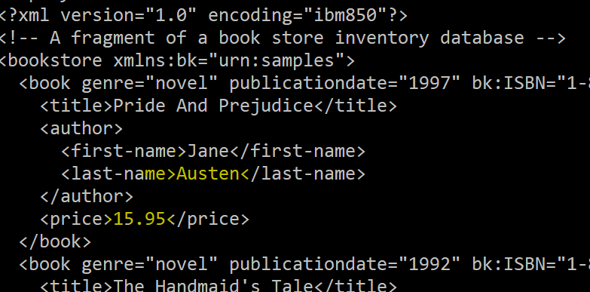
Namespace System.Xml
System.XmlDocument Class
Encontrar um conjunto de nodos (pesquisa por valor de atributo):
...
XmlNodeList nodeList;
XmlNode root = doc.DocumentElement;
nodeList=
root.SelectNodes("book[author/last-name='Austen']");
// alterar o preço de cada um dos livros...
foreach (XmlNode book in nodeList)
{
book.LastChild.InnerText="15.95";
}
Console.WriteLine("mostrar o documento XML modificado..."););
doc.Save(Console.Out);
Notes:
Get a collection of nodes
This example selects all books where the author's last name is Austen, and then changes the price of those books.
descendant::book[author/last-name='Austen']

Slide 28
Transformação de XML
No contexto de dados em formato XML:
Ler documentos
Escrever documentos
Percorrer documentos
Procurar em documentos
Filtrar documentos
Alterar documentos
Load XML into the document object model
Validate it against a schema or DTD
Navigate the document tree
Find nodes
Edit nodes
Add nodes
Remove nodes
Position nodes
Notes:
Luís Ferreira (2016), Integração de Sistemas de Informação, Parte I - versão 5.0 - Janeiro 2016
, Parte II - versão 1.0 - Janeiro 2017
Bibliografia complementar:
Urls
http://www.tutorialspoint.com/webservices/
http://www.linkeddatatools.com/
http://eai.ittoolbox.com/

Slide 29
Transformação de XML
Summary:
Load XML into the document object model
https://docs.microsoft.com/en-us/dotnet/api/system.xml.xmldocument?view=net-5.0#Load
Validate it against a schema or DTD
https://docs.microsoft.com/en-us/dotnet/api/system.xml.xmldocument?view=net-5.0#Validation
Navigate the document tree
https://docs.microsoft.com/en-us/dotnet/api/system.xml.xmldocument?view=net-5.0#Navigate
Find nodes
https://docs.microsoft.com/en-us/dotnet/api/system.xml.xmldocument?view=net-5.0#Find
Notes:
Luís Ferreira (2016), Integração de Sistemas de Informação, Parte I - versão 5.0 - Janeiro 2016
, Parte II - versão 1.0 - Janeiro 2017
Bibliografia complementar:
Urls
http://www.tutorialspoint.com/webservices/
http://www.linkeddatatools.com/
http://eai.ittoolbox.com/

Slide 30
Transformação de XML
Summary:
Edit nodes
    https://docs.microsoft.com/en-us/dotnet/api/system.xml.xmldocument?view=net-5.0#Edit
Add nodes
https://docs.microsoft.com/en-us/dotnet/api/system.xml.xmldocument?view=net-5.0#Add
Remove nodes
https://docs.microsoft.com/en-us/dotnet/api/system.xml.xmldocument?view=net-5.0#Remove
Position nodes
https://docs.microsoft.com/en-us/dotnet/api/system.xml.xmldocument?view=net-5.0#Position
Notes:
Luís Ferreira (2016), Integração de Sistemas de Informação, Parte I - versão 5.0 - Janeiro 2016
, Parte II - versão 1.0 - Janeiro 2017
Bibliografia complementar:
Urls
http://www.tutorialspoint.com/webservices/
http://www.linkeddatatools.com/
http://eai.ittoolbox.com/

Slide 31
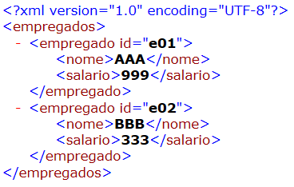
Exercício
Ver exemplo TreeNode em XML_C#
Desenvolva uma pequena aplicação em C# que permita navegar na estrutura de um dado ficheiro XML.
Sugestões: Windows Forms App
    Widget TreeView para apresentar a estrutura
    https://docs.microsoft.com/en-us/dotnet/api/system.windows.forms.treeview
    (pode recorrer a uma TreeNode para estruturar a informação)
    Como exemplo considere o exemplo empregados.xml
Notes:
https://docs.microsoft.com/en-us/dotnet/standard/data/xml/select-nodes-using-xpath-navigation
Select Nodes Using XPath Navigation
03/30/2017
4 minutes to read
+5
The XML Document Object Model (DOM) contains methods that allow you to use XML Path Language (XPath) navigation to query information in the DOM. You can use XPath to find a single, specific node or to find all nodes that match some criteria.

Slide 32
References
Beginning XML with C# 7 - XML Processing and Data Access for C# Developers, Bipin Joshi, Apress, 2017
https://link.springer.com/content/pdf/bfm%3A978-1-4842-3105-0%2F1.pdf
XML with C#
https://csharp.net-tutorials.com/xml/introduction/
C# XML Document
https://zetcode.com/csharp/xmldocument/
Notes:
https://docs.microsoft.com/en-us/dotnet/standard/data/xml/select-nodes-using-xpath-navigation
Select Nodes Using XPath Navigation
03/30/2017
4 minutes to read
+5
The XML Document Object Model (DOM) contains methods that allow you to use XML Path Language (XPath) navigation to query information in the DOM. You can use XPath to find a single, specific node or to find all nodes that match some criteria.

